Slide 1

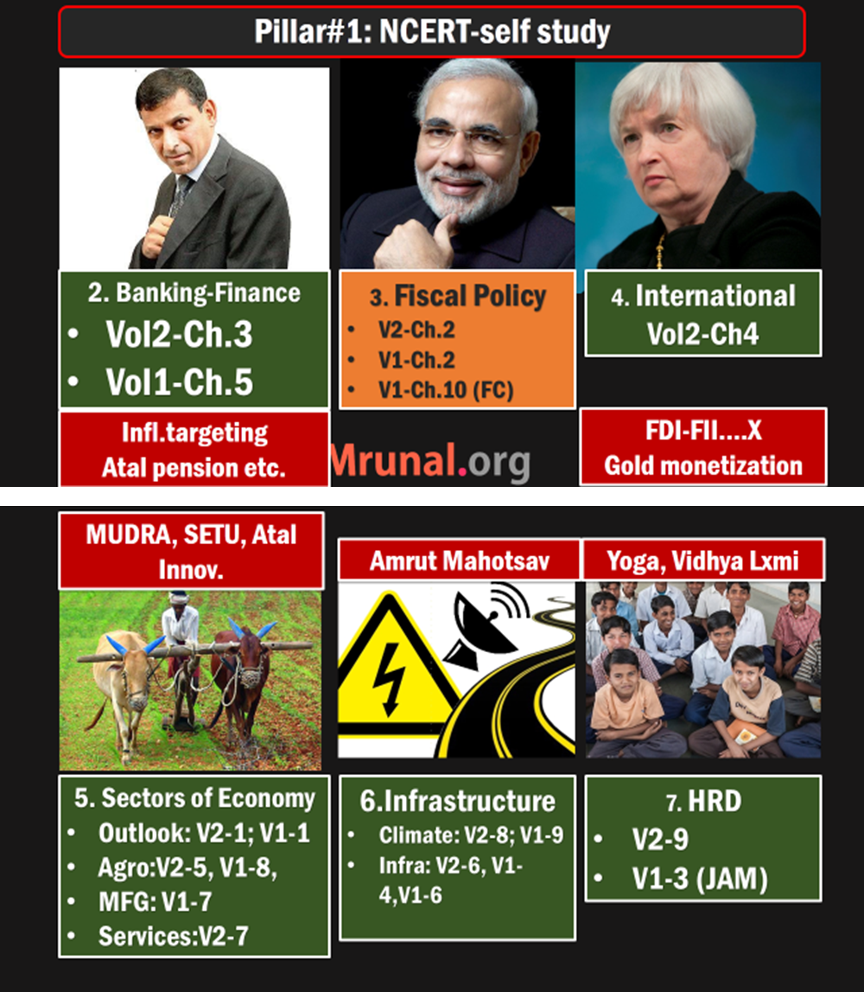
Env. Vs Economy
1st world vs 3rd World
Climate Finance
Environment clearance
Today’s topic
Legal & Constitutional Angles
Laws Before & after independence
Green Law Panel
Pollution ▼, Org. reforms
FRFD, DPSP, 7th Schedule
Wildlife protection, Environment clearance
Type of areas
Parks, Sanctuaries, Reserves, Hotspots, PA
Go & No Go areas?

Slide 2
Environment MCQs: What to focus?
Flora-fauna: location, critically endangered
Fungi and algae- their use in biotechnology
GHG: names ascending, descending
Theory: chemistry, cause-consequence, A&R
Chronology- summits, conventions, org.
Org: HQ, Chairman, parent body
Summit: location, theme, outcome
Pacts/conventions /Protocol: Salient feature, application to India-what & where? (GSM-2)
India schemes/policies/funds/bodies

Slide 3
L8/P2: Combating Climate Change
Rio Evolution, IPCC AR5
Intl. Finance
Natl. Finance
Kyoto to Paris
India’s Stand

Slide 4
1992: Earth Summit @Rio De Janerio, Brazil
Biodiversity (CBD)
Aichi: 2010
Sus.DVLP
Agenda 21
RIO+20
Climate Change (UNFCCC)
IPCC ’88
UNFCCC ’92-93
Kyoto ’97
Lima ‘14
Paris ’15 (post’20)
Nagoya Genetic resources: 2010
CBD ’92-93
Cartagena Biosafety ‘2000
NAPCC ‘08
MDG’15 : SDG
Self study: Mrunal.org

Slide 5
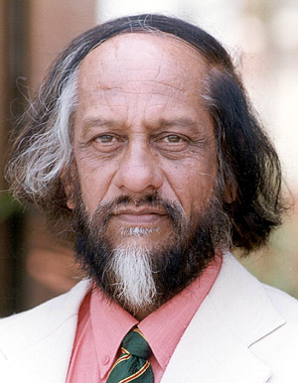
Climate change Org.
IPCC
UNFCCC
Intergovernmental Panel on Climate Change
UN framework convention on climate change
5th Assessment report (AR5-2014)
Kyoto Protocol, Climate finance

Slide 6
Origin
IPCC: 1988
UNFCCC: 1992
UNEP + WMO
Rio Earth summit
HQ: Geneva
HQ: UN Secretariat @NY

Slide 7
Members
IPCC
UNFCCC
195 members
196
Chairman Dr.Rajendra Pachauri
Christina Figueres (XO Sec)

Slide 8
Chairman?
IPCC
2007: Nobel Peace IPCC + Al Gore
Feb-2015: Rajendra Pachauri resigned after sexual harassment case. served ~13 years.
IPCC: 195 members states, secret ballot, vote in October summit.
IPCC has regional quotas for bureau-chief position.
5th Assessment report (AR5-2014)

Slide 9
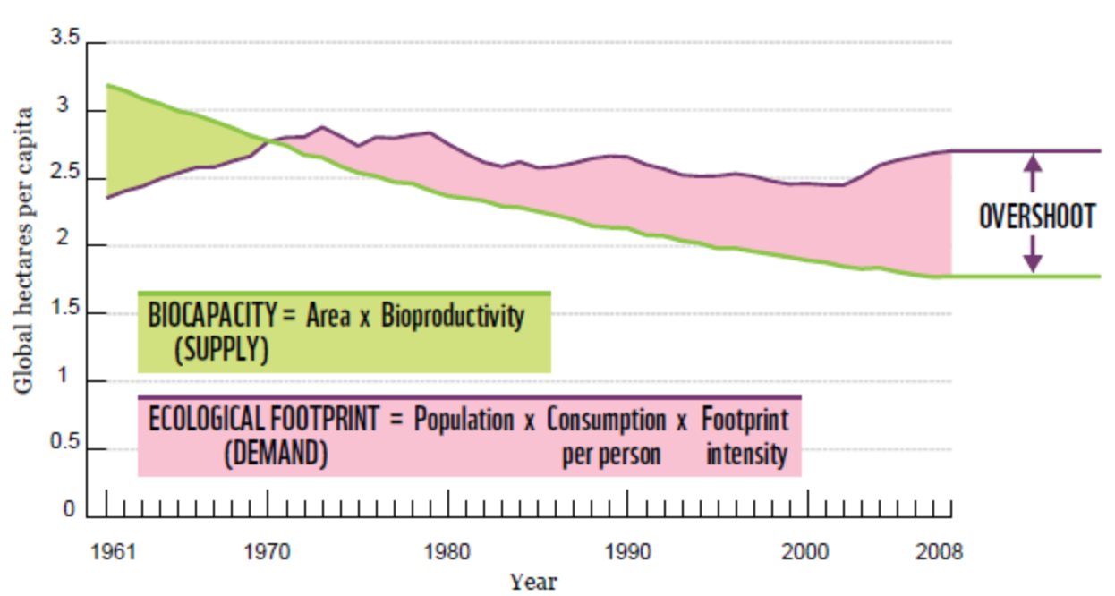
Ecological Overshoot: Ecological footprint of humanity > Biocapacity of earth to regenerate
Industrial revolution till 2100: total CO₂ allowance: 2900 Gigatons
we already used 2/3rd and finish rest within 30 years.

Slide 10
Earth overshoot day | Ecological Debt Day
Earth capacity to
regenerate
Bio-degrade
Human
waste
Litter
Biomass consumption
NGO Global footprint Network.
2014: August (8th month)
12 month’s quota used in 8
2030: need two earths
World Environment day June 5
Earth Hour: March 29 WWF, switch off lights since ‘07
Notes:
19th august

Slide 11
2014: Correct Statements on Earth Hour
It is an initiative of UNEP and UNESCO.
It is a movement Where participants switch off the lights for one hour on a certain day every year.
It is a movement to raise the awareness about the climate change and the need to save the planet.
Ans. Only 2 and 3

Slide 12
IPCC AR5: GHG to hurt food security + Economy
▲Anthropogenic GHG
Deforestation
Tropical + Temperate= Wheat, rice, maize ▼
Economy
Disasters ▲
Livestock meat
Fossil fuel
Pak. Mountains ▲: 2 crops (wheat + Maize)
Gangetic Wheat ▼ 50%
Food security
Cost of living ▲
Outdoor activities ▼
JE + Dengue ▲
Notes:
if you stay indoor, more electricity used….more problem
(plant kg- only 3% turn to meat)

Slide 13
IPCC: AR5- Source of GHG (2010)
Ascending, Descending order important for MCQs

Slide 14
IPCC AR5: C0₂ Emission share (out of 100%)
Only fossil fuel + cement: (1) China, (2) US (3) EU
Per capital emission in above areas: India, Brazil, S.Africa= bottom 100
Ascending, Descending order important for MCQs

Slide 15
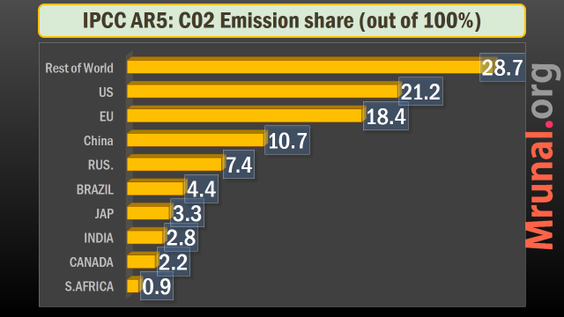
IPCC AR5: C0₂ Emission share -BRICS
Ascending, Descending order important for MCQs

Slide 16

By end of 21st Cent.
IPCC- AR5
Low emission
1.5
High emission
2
Worst case
4.8
We must limit global warming within 2C (3.6F) above
Pre-industrial level

Slide 17
So far
IPCC- AR5
GHG
Food security
Economy
Ranking
Source wise
Country wise
Eco. overshoot
Notes:
How? Decrease country wise.

Slide 18
L8/P2: Combating Climate Change
Rio Evolution, IPCC AR5
Intl. Finance
Natl. Finance
Kyoto to Paris
India’s Stand

Slide 19
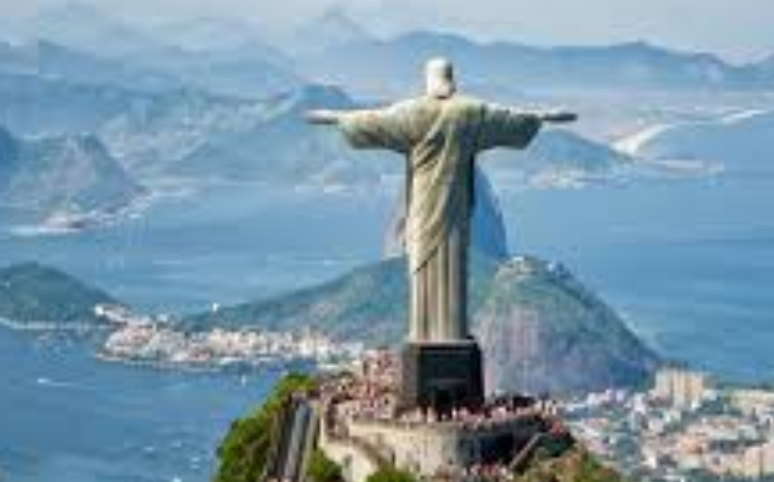

Rio 92=>UNFCCC (WEF 93)=>Kyoto 97=>Annex.
Rio Summit
1992
UNFCCC
WEF 93
Kyoto
1997
With effective from
Notes:
Chirst the re-deemer

Slide 20
UNFCCC => Kyoto Annex 1 and 2
1
2
Nations who pledged to ▼GHG
Nations who’ll give finance to 3rd world
Russia: 1 but not 2
USA: 1+2 but not ratified
Non-Annex: India, China, Brazil, S.Africa et al.
Canada: left the game

Slide 21
UNFCCC =>Kyoto Annex A and B
A
B
List of GHG- total 6
Quota of Annex-1
Carbon dioxide (CO₂)
Methane (CH₄)
Nitrous oxide (N₂O)
Sulphur hexafluoride (SF₆)
Perfluorocarbons (PFCs)
Hydrofluorocarbons (HFCs)

Slide 22

N₂O factoids
Kyoto-GHG
Nitrous oxide (Humphry Davy named)
Aka di-nitrous monoxide
Neutral oxide. (neither acidic / base)
sweet taste-odour
cause mild hysteria / laugh= laughing gas
weak anesthetic in dentistry
Bacteriostatic, speed-engines
Notes:
CH₄: global warming potential 21 x time more than CO₂
& designed miners’ safety lamp

Slide 23
N₂O factoids
Kyoto-GHG
Source: farmland ►ammonium nitrate decomposed ► N₂O
Cars with catalytic converters
GHG Qty: C0₂ > CH₄ > N₂O (in some nations)
(in theory) 320 x more global warmer than CO₂
Ozone Depletory as well
Notes:
CH₄: global warming potential 21 x time more than CO₂
http://utslappisiffror.naturvardsverket.se/en/Substances/Greenhouse-gases/Nitrous-oxide/

Slide 24

SF₆ factoids
Kyoto-GHG
Sulfur Hexafluoride
Man-made gas- used and emitted from following:
Electrical insulator in transformer, switch-gear
Used in Magnesium smelting
5x heavier than air
Highest global warming potential (23k x CO₂)
Notes:
CH₄: global warming potential 21 x time more than CO₂
http://utslappisiffror.naturvardsverket.se/en/Substances/Greenhouse-gases/Nitrous-oxide/
Suphur hexafluoride (SF6)
Sulphur hexafluoride (SF6), SF6
At environmental temperatures sulphur hexafluoride is a colourless, odourless, non-toxic gas of high chemical stability and inertness. It is also non-flammable and about 5 times heavier than air – one of the heaviest known gases.
Use
The major use of sulphur hexafluoride is in the electricity supply industry, where it is used as an electrical insulator in transformers and switch-gear, and in magnesium smelting because of its inertness. It also has some minor use in the semiconductor sector, as tracer gas for atmospheric analysis, in tennis balls, high performance vehicle tyres and in the cushioning soles of some trainers.
Major emissions
Sulphur hexafluoride is a man-made chemical not found naturally in the environment. The major sources of sulphur hexafluoride release include leakage from electrical switchgear, from magnesium smelting processes and use in semiconductor manufacture.
Impacts on human health and environment
Excessive exposure to sulphur hexafluoride may affect the brain. The main impact of sulphur hexafluoride on the environment is as a greenhouse gas, influencing climate change. Consequently sulphur hexafluoride is controlled under the Kyoto Protocol. Of the internationally monitored greenhouse gases it has by far the highest global warming potential (23,000 times that of carbon dioxide), however it is only released in small amounts. Due to its stability it has a very long atmospheric lifetime.

Slide 25
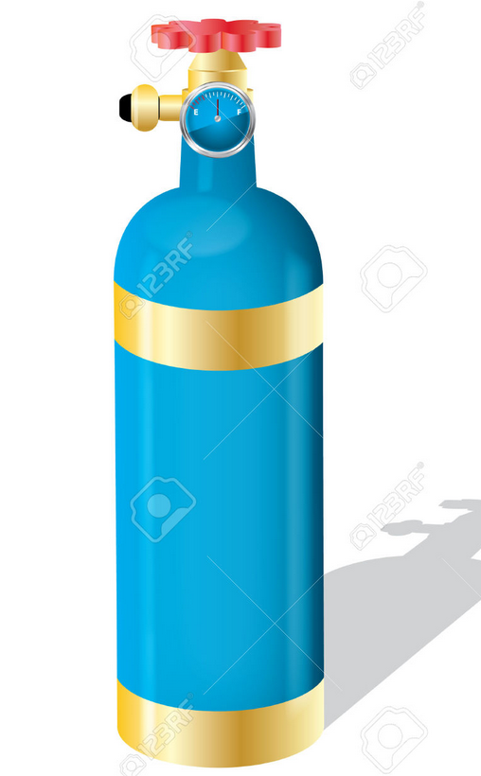
PFCs factoids
Kyoto-GHG
Perfluorocarbons (PFCs)
Man made.
color, odor, flammable? NOPE
Semiconductor industry
Blending with HFC, HCFC in refrig. (before Montreal)
Source: Aluminum production, leakages in semiconductor
CH₄ gas breakdown in 10 years but PFCs can last for 1000s years
Notes:
CH₄: global warming potential 21 x time more than CO₂
http://utslappisiffror.naturvardsverket.se/en/Substances/Greenhouse-gases/Nitrous-oxide/
Suphur hexafluoride (SF6)
Sulphur hexafluoride (SF6), SF6
At environmental temperatures sulphur hexafluoride is a colourless, odourless, non-toxic gas of high chemical stability and inertness. It is also non-flammable and about 5 times heavier than air – one of the heaviest known gases.
Use
The major use of sulphur hexafluoride is in the electricity supply industry, where it is used as an electrical insulator in transformers and switch-gear, and in magnesium smelting because of its inertness. It also has some minor use in the semiconductor sector, as tracer gas for atmospheric analysis, in tennis balls, high performance vehicle tyres and in the cushioning soles of some trainers.
Major emissions
Sulphur hexafluoride is a man-made chemical not found naturally in the environment. The major sources of sulphur hexafluoride release include leakage from electrical switchgear, from magnesium smelting processes and use in semiconductor manufacture.
Impacts on human health and environment
Excessive exposure to sulphur hexafluoride may affect the brain. The main impact of sulphur hexafluoride on the environment is as a greenhouse gas, influencing climate change. Consequently sulphur hexafluoride is controlled under the Kyoto Protocol. Of the internationally monitored greenhouse gases it has by far the highest global warming potential (23,000 times that of carbon dioxide), however it is only released in small amounts. Due to its stability it has a very long atmospheric lifetime.

Slide 26
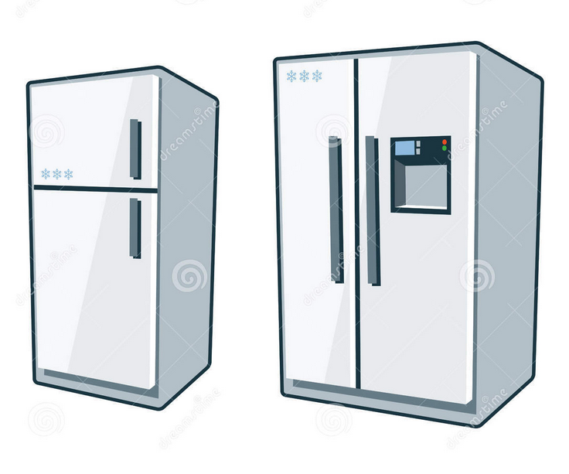
HFCs factoids
Kyoto-GHG
Hydro floro carbons
Post Montreal substitutes
Color-odour: no, Man-made yes
post Montreal treaty substitutes for CFC, HCFCs
In Refrigeration, aerosols
Can last for 100s years
Notes:
CH₄: global warming potential 21 x time more than CO₂
http://utslappisiffror.naturvardsverket.se/en/Substances/Greenhouse-gases/Nitrous-oxide/
Suphur hexafluoride (SF6)
Sulphur hexafluoride (SF6), SF6
At environmental temperatures sulphur hexafluoride is a colourless, odourless, non-toxic gas of high chemical stability and inertness. It is also non-flammable and about 5 times heavier than air – one of the heaviest known gases.
Use
The major use of sulphur hexafluoride is in the electricity supply industry, where it is used as an electrical insulator in transformers and switch-gear, and in magnesium smelting because of its inertness. It also has some minor use in the semiconductor sector, as tracer gas for atmospheric analysis, in tennis balls, high performance vehicle tyres and in the cushioning soles of some trainers.
Major emissions
Sulphur hexafluoride is a man-made chemical not found naturally in the environment. The major sources of sulphur hexafluoride release include leakage from electrical switchgear, from magnesium smelting processes and use in semiconductor manufacture.
Impacts on human health and environment
Excessive exposure to sulphur hexafluoride may affect the brain. The main impact of sulphur hexafluoride on the environment is as a greenhouse gas, influencing climate change. Consequently sulphur hexafluoride is controlled under the Kyoto Protocol. Of the internationally monitored greenhouse gases it has by far the highest global warming potential (23,000 times that of carbon dioxide), however it is only released in small amounts. Due to its stability it has a very long atmospheric lifetime.

Slide 27
Green house warming potential (if C0₂=1)
SF₆= 23k
N₂0=320
CH₄=21
HFCs=100-1300
PFCs=5k-10k

Slide 28
Ozone depletion
NCERT Class 11 Chemistry, Chapter 14 Environment chemistry
Ozone: Page 405 onwards. CFC – toxic or not? Reactive or not? For chorine radicals are they reactive agents or transporting agents? Used in Plastic foam making or not? Role of polar stratospheric clouds?

Slide 29
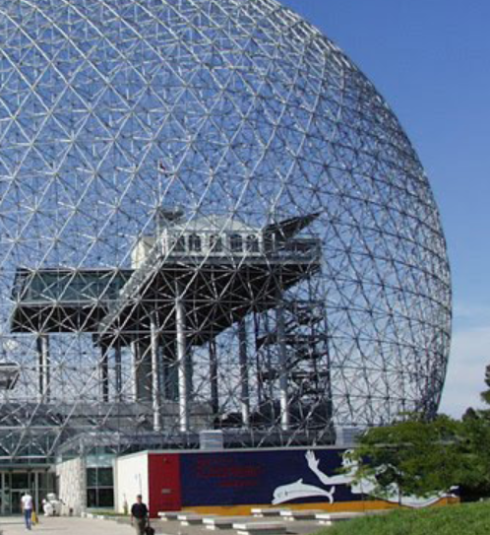
Montreal protocol WEF‘89
Ozone
Phase out Chloro-fluorocarbons (CFCs) / Freons
Phase out Hydro-chloro-fluorocarbons (HCFCs)
Hydro-fluoro-carbons (HFCs) continue:
GHG yes
Ozone depletion no

Slide 30
Find correct statement(s)
Both CFC and HFC can be used in refrigeration
Kyoto Protocol aims to curb HFC while Montreal protocol aims to curb CFC.
Both A and B
Neither A nor B

Slide 31
Conventional logic: ans. C both right
Both CFC and HFC can be used in refrigeration
Kyoto Protocol aims to curb HFC while Montreal protocol aims to curb CFC.
Both A and B
Neither A nor B

Slide 32
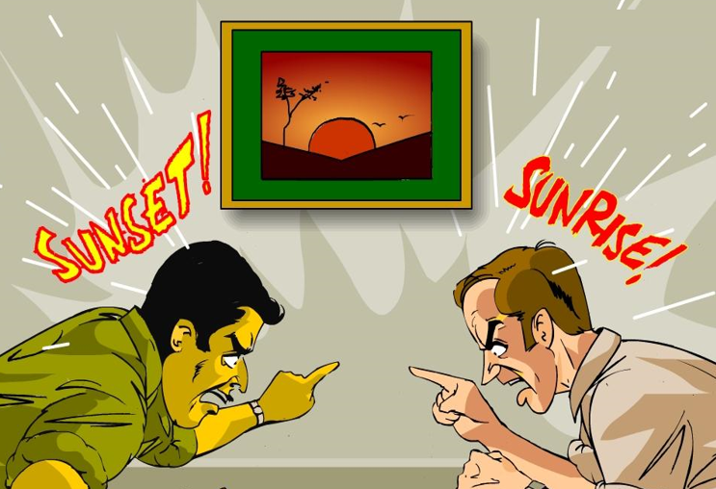
Multiple interpretation (!)
Both CFC and HFC can be used in refrigeration: in theory yes, but in practice no- because of Montreal
Kyoto Protocol aims to curb HFC while Montreal protocol aims to curb CFC.
Both A and B
Neither A nor B

Slide 33
Back to UNFCCC=> Kyoto 97 => Annex
1
2
Nations who pledged to ▼GHG
Nations who’ll give finance to 3rd world
A
B
List of GHG- total 6
Quota of Annex-A

Slide 34
Kyoto more details
Kyoto http://mrunal.org/2012/09/climate-change-kyoto-protocol-carbon-trading.html

Slide 35
L8/P2: Combating Climate Change
Rio Evolution
Intl. Finance
Natl. Finance
Kyoto to Paris
India’s Stand

Slide 36
Roadmap for Climate Change (UNFCCC)
Kyoto ‘97
Annex 1 Countries to ▼GHG as per Annex-B Quota
Qatar, 2012
Kyoto extended till 2020
Paris, 2015
What to do for Post-2020
But Post-2020 Agenda be developed by 2015.

Slide 37
Kyoto Deadline 2020
MDG Deadline: 2015
92: Rio► UNFCC
97: Kyoto
15, Dec: Paris
Rio 92 ► Agenda 21
12: Rio+20
00’ UN MDG
15, Sept: UN SDG
Integrate for Post-2020 agenda

Slide 38
Lima Summit, 2014, December
Rio 1992
Lima 2014
Kyoto 97
Annex
Quota
20th CoP UNFCCC
10th CoP to Kyoto
CBD(Biodiversity)
UNFCCC
Sus.DVLP
12: Qatar (Kyoto xtnd 2020) > 13: Warsaw > 14: Lima (190) > 15: Paris

Slide 39

Lima Summit Dec 2014
UNFCCC
We must limit global warming to only 2C above pre-industrial level.
But, at present trend, ~4C. (IPCC AR-5: 4.8 in worst case scenario)
Present GHG emission 50 Gigatons
If ▼ to 41 Gigatons, then 2C target achieved. (= MITIGATION)
CBDR will be followed
Notes:
IPCC AR5- worst case scenario is 4.8 celcius

Slide 40
Lima Summit Dec 2014
UNFCCC
By May 2015: Negotiation text for Paris Agreement to finalize. (not done, Bonn Germany- hanging till Aug-2015)
By Oct. 15: GHG ▼Intended nationally determined contributions (INDC) submit to UNFCCC
By Nov. 2015: UNFCCC to synthesize
INDC has to be >> than +nt commitment
Russia: 70-75% of 1990 level, by 2030
Notes:
The substitution of the phrase “may include” for “shall include” in regard to the elements of the INDCs was one of the compromises that was necessary to gain the approval of developing countries. So, the U.S.-favored requirement for the use of transparent elements in INDCs that would facilitate comparisons among countries was dropped.
However, at least one negotiating team with whom I met in Lima maintained that the analyses and comparisons of INDCs that will inevitably be carried out by various NGOs and research organizations (including universities) will provide the needed transparency and therefore the needed encouragement to countries for greater ambition.

Slide 41
Lima Summit Criticism
Nothing binding
Nations “invited” to give commitments when they’re “ready to do so” = no legal deadlines, even on 1st world!
Funding
$100 Bn by 2020: but no roadmap
Pledge can’t be evaluated by UNFCCC/ foreign auditors- India-China says it’ll hurt sovereignty
Hardly 10 bn pledged in Lima
No definition of “Loss and Damages”
Countries “May include” base year, deadline, planning.
Notes:
A work programme was also established under the Committee—it has an array of actions areas, including enhancing the understanding of how loss and damage due to climate change affects particularly vulnerable developing countries and populations including indigenous or minority status ones.

Slide 42
Lima Summit Criticism
Documentation
Focused more on Adaptation, than mitigation (GHG▼)
Media
Draft text no…will work in May 2015
just soundbites of summaries rather than analysis.
China-India call for “CBDR” portrayed as “obstacle”
Bonn (Germany): 85 pages prepared, again meet Aug.

Slide 43
Next: जलवायु परिवर्तन पर भारत का रूख
Rio Evolution, IPCC AR5
Intl. Finance
Natl. Finance
Kyoto to Paris
India’s Stand

Slide 44

India’s stand on climate change?
CBDR
Funding
Tech Transfer
Yet to reap fruits
poverty
Energy access to all
50:50
Adaptation
Mitigation
IPR
Price tag
1st world do it

Slide 45
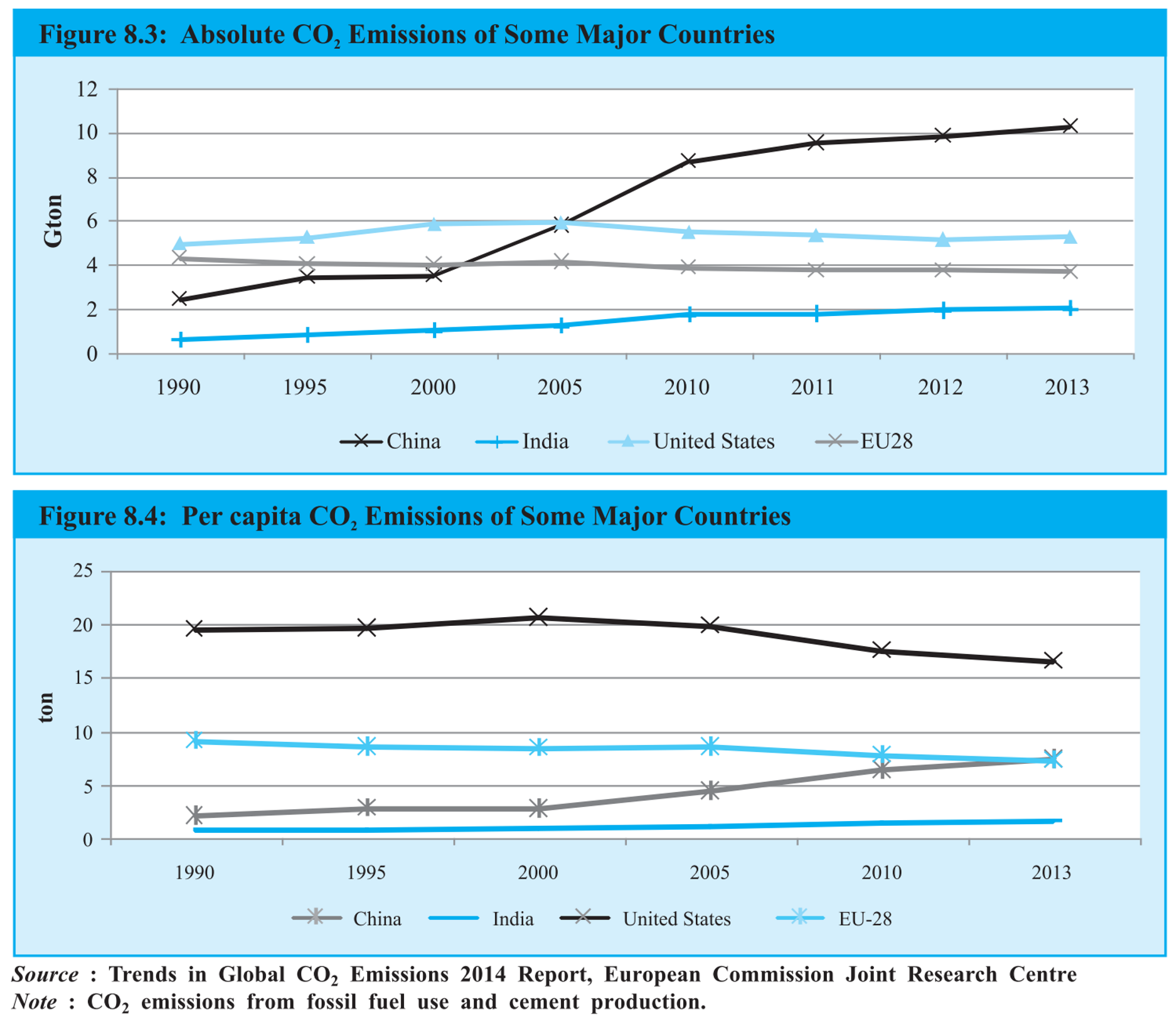
India’s per capita & Absolute GHG emission lower
India’s total & per capita emission lower than 1st world.
1850 to 2011: CO₂ Emissions world: USA 21%, EU 18%, India 3%

Slide 46
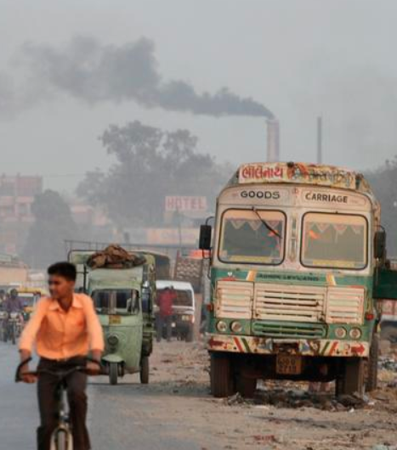
India’s stand
Climate Change
common but differentiated responsibilities (CBDR)
3rd world not to bear same responsibilities as 1st world
Because we’re not the cause of anthropogenic GHG emission in previous decades.
Carbon budget, global atmospheric resources ought to be distributed in fair manner.

Slide 47
India’s stand
Climate change
UNFCCC - India accepts nothing legally binding. (May 2015)
We’ll Coordinate with likeminded countries to protect three long term interests.

Slide 48
India’s 3 long term interests behind CBDR
Balance Environment vs. Economy
Eradicate Poverty
Energy Access to all
Notes:
Protect Long term interests

Slide 49
India’s stand
Climate change
Voluntary goal 2020
▼ emission intensity of GDP
by 20-25%
compared to 2005. (agro. Emission excluded)
For this: NAPCC, Solar mission etc.
50:50 weightage to both Adaptation and Mitigation

Slide 50
India’s stand on climate change?
CBDR
Funding
Tech Transfer
Yet to reap fruits
poverty
Energy access to all
50:50
Adaptation
Mitigation
IPR
Price tag
1st world do it

Slide 51

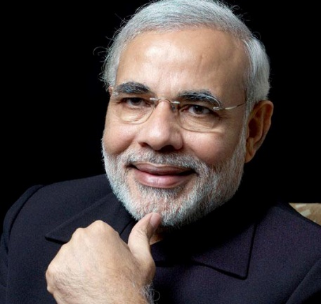
Difference as per IPCC 2007 report
Priority here
Mitigation
Direct GHG ▼
Adaptation
Adjusting to CC, to ▼ vulnerability
Biofuel: CO₂ ▼
Proper Manure storage: CH₄ ▼
Proper nitro-fert.use : N₂0 ▼
Rain water harvest
Water desalination plant
Flood embankment
Priority here
Due to Kyoto

Slide 52
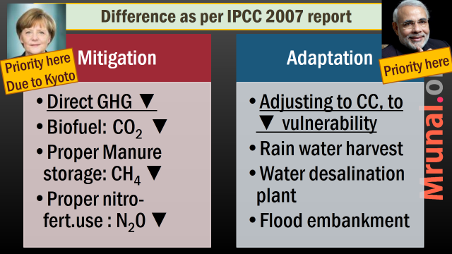
India’s stand
1st world wants to fund Mitigation >> adaptation
India wants 50:50 focus on both.
Green climate fund (GCF) says the same

Slide 53
India’s stand on climate change?
CBDR
Funding
Tech Transfer
Yet to reap fruits
poverty
Energy access to all
50:50
Adaptation
Mitigation
IPR
Price tag
1st world do it

Slide 54

India’s stand $$ & Tech transfer
Climate change
UNFCCC Art.11- 1st world's to give $$ & Tech to 3rd world
1st world frontrunner in clean technology research, while 3rd world not enough money / manpower
Protect IPR-yes, BUT IPR price-tag should not hamper tech transfer.
So either 1st world bear IPR-cost or give discount to 3rd World.

Slide 55
India’s stand on climate change?
CBDR
Funding
Tech Transfer
Yet to reap fruits
poverty
Energy access to all
50:50
Adaptation
Mitigation
IPR
Price tag
1st world do it

Slide 56
Mock question
“India’s stand on Post-2020 climate change framework, is guided by its peculiar socio-economic and demographic profile.” Elaborate.
Demo.dividend: promote MSME,
poverty, India-Bharat: Energy/electricity, water-access, fert.subsidies, adaptation-mitigation 50:50….so on

Slide 57
Next: जलवायु परिवर्तन पर भारत का रूख
Rio Evolution
Intl. Finance
Natl. Finance
Kyoto to Paris
India’s Stand

Slide 58

International Climate finance
Carbon market
GEF
Kyoto Protocol
GCF
Songdo, SK
Washington

Slide 59
Back to UNFCCC=> Kyoto 97 => Annex
1
2
Nations who pledged to ▼GHG
Nations who’ll give finance to 3rd world
A
B
List of GHG- total 6
Quota of Annex-A

Slide 60
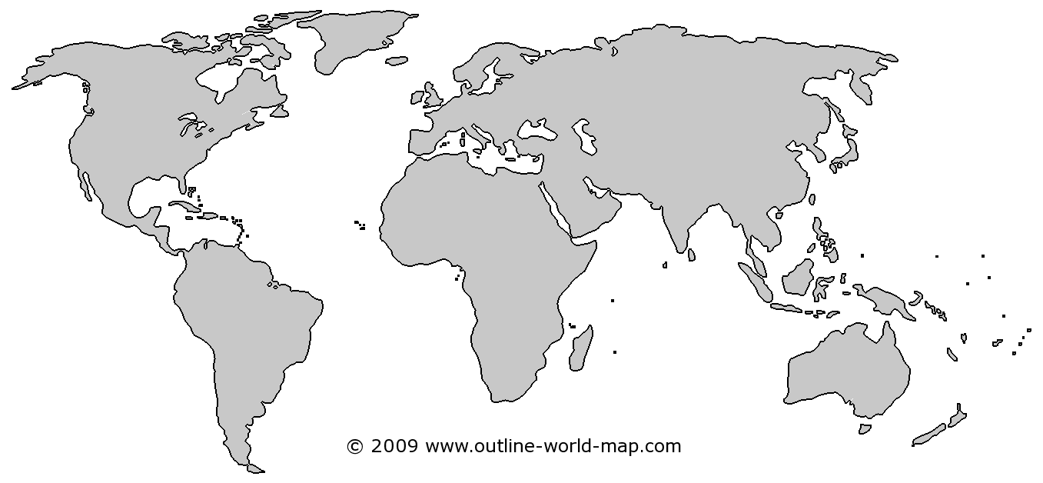


Kyoto: clean Development mechanism (CDM)
Germany emission quota: 100 Kyoto Units (=1 mt. ton)
1 Chemical Co. legally binding target 10 Kyoto units
Ankleshwar Chem. Co
10 ton CO₂=Baseline emission

Slide 61
Kyoto: clean Development mechanism (CDM)
Germany emission quota: 100 Kyoto Units (=1 mt. ton)
1 Chemical Co. legally binding target 10 Kyoto units
After German investment
Ankleshwar Chem. Co emits 9 10 ton CO₂
1 Carbon credit / CER
certified emission reduction
Can sell to 3rd party
2008: 1CER = $20
2012: 1CER =$5

Slide 62
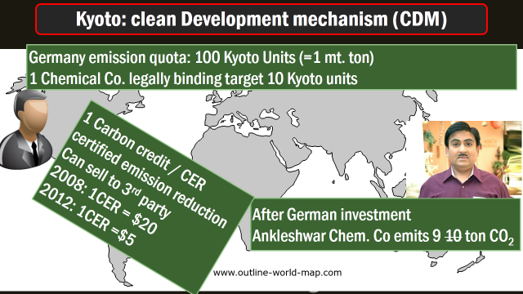
Carbon market and UNFCCC
2% of CER goes to UNFCCC Adaptation fund
From that National implementation entity gets $$
For India: NABARD, the only NIE in Asia-Pacific
NABARD using $$ for Bengal agro & Andhra fisheries.

Slide 63
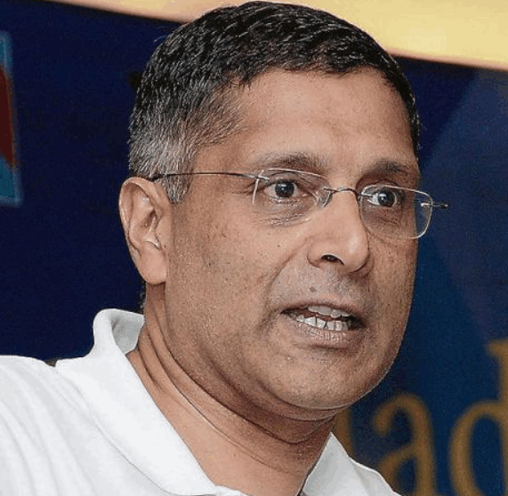
UNFCCC=>Kyoto Carbon market CDM
Survey notes
Kyoto Clean Development mechanism (CDM)
CDM: multilateral carbon market
155 nations (3/4th countries of world) in CDM
Most effective for mitigation (▼GHG)
Total CDM projects: No. 1 China, No.2 India (13%)
>Rs.5.5 L.CR. CDM projects in India
National Clean Development Mechanism (CDM) Authority under MoEF Secretary (IAS)

Slide 64
Why Carbon market Down?
Survey notes
Canada pulled out, Russia-Japan not accepting new commitments. = demand for Kyoto credit is ▼
CER Prices ▼ Post-Eurozone crisis.
Pre-2020 summits like Lima, have less focus on mitigation (GHG▼) => Carbon market prices ▼
Uncertainty, how it’ll be subsumed in Post-2020

Slide 65
International Climate finance
Carbon market
GEF
Kyoto Protocol
GCF
Songdo, SK
Washington

Slide 66
Intl. Global environment facility in World Bank ‘91
Biodiversity: CBD
Stockholm: Persistent Organic pollutants (Sweden)
UN convention to combat Desertification
Climate change: UNFCCC: Art.11
Minamata convention on Mercury (Jap.)
Notes:
Convention on climate change.

Slide 67
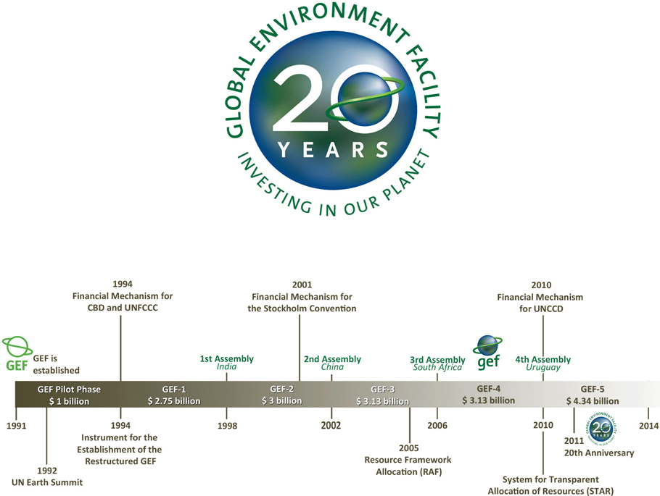
Global environment facility (Washington, 1991)

Slide 68

UNFCCC Art. 11: $$ + Tech transfer
1st world pledges $4 bn.
6th cycle (2014-18)
So far India got ~480 mil.: out of that majority for mitigation,
hardly 10 for adaptation projects
India got $130 mil.
Out of that 80 mil. for mitigation
GEF @Washington
manages 2 UNFCCC funds
L.D.C. Fund
Special Climate change fund
Notes:
from >100 per barrel to <50$
China, EU Growth▼=oil demand ▼
US oil + shale gas production ▲
OPEC oligopoly ▼, S.Arabia did not ▼ production
Survey predicts: $60-65 / barrel, so, inflation and CAD will be moderate for 2015-16

Slide 69
International Climate finance
Carbon market
GEF
Kyoto Protocol
GCF
Songdo, SK
Washington

Slide 70
Green Climate Fund: UNFCCC Cancun summit ‘10
Copenhagen’09
GCF mentioned
Cancun’10
GCF: $100 by 2020
GCF
Songdo, S.Korea
Germany, France pledged $1 bn each
USA: 3 billion over 4 years.
Durban’11
Governing str.
Lima’14
Notes:
from >100 per barrel to <50$
China, EU Growth▼=oil demand ▼
US oil + shale gas production ▲
OPEC oligopoly ▼, S.Arabia did not ▼ production
Survey predicts: $60-65 / barrel, so, inflation and CAD will be moderate for 2015-16

Slide 71

Green Climate fund
Intl.finance
Separate funding for private cos.
Gender plan coming soon.
50:50 on adaptation vs. mitigation
Country-driven approach: recipient countries to decide how to use $$.
India: MoEF is nodal agency

Slide 72


Difference GEF vs GCF
Global Env.Faci.
Washington, World Bank ‘91
Green Climate Fund
Songdo, S.Korea (9-11)
CC, Biodiversity, Pollution, Desertification
Only CC (50:50)
Total __$$ in __ rounds
Chairman ____?
Total ___ $$ pledges
Chairman ___?

Slide 73
International Climate finance
Carbon market
GEF
Kyoto Protocol
GCF
Songdo, SK
Washington

Slide 74
Next: national schemes and finance against CC
Rio Evolution
Intl. Finance
Natl. Finance
Kyoto to Paris
India’s Stand

Slide 75
National finance, funding against Climate change
Taxation
Budget 2015
NAPCC
Nehru
Funds
New funds
Coal Cess
PAT
Misc.
CAMPA
PSL

Slide 76
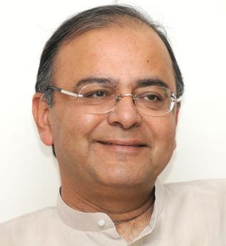
Taxation for clean Development
Budget 2015
Custom Duty ▼- hybrid vehicle, Solar water, LED parts
Excise duty ▼ Solar PV, heater, Wind Power generators, hybrid vehicle parts
Service tax exempted: affluent treatment park
Notes:
From Government side: capital/interest subsidy, accelerated depreciation, and nil/concessional excise and customs duties

Slide 77
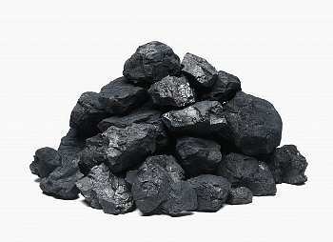
Coal cess
Natl. Finance
Very few nations have Carbon Tax
Coal Cess Rs. 100 200 per ton. (both desi & imported)
~17k crores collected & sent to National Clean Energy fund.
Road Cess on petrol-diesel
If need 2% swachh Bharat cess on service tax

Slide 78

Fossil fuels
Carbon tax
Excise and custom duty on fossil fuels = 1 type of carbon tax.
Gradually, petrol-diesel deregulated
Subsidy ▼, Taxes ▲
In a year: 11 million tonnes CO₂ ▼ 17k crores in tax collection
But insignificant to negative externalities.

Slide 79
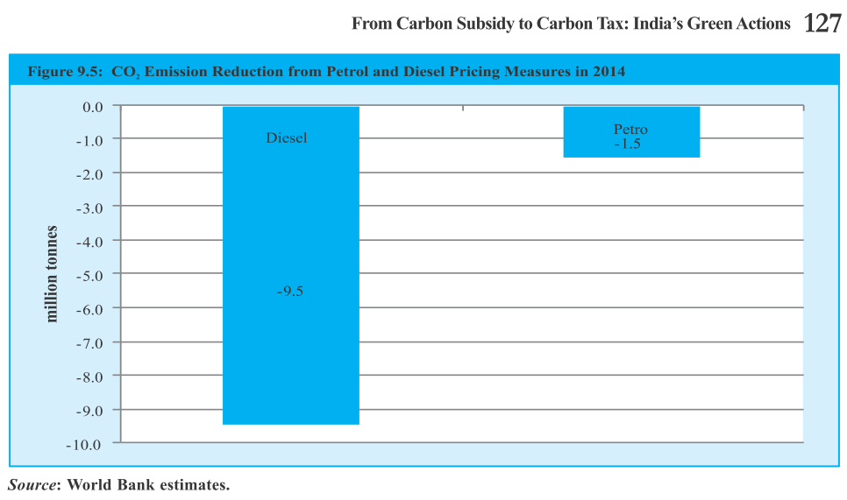
Higher Taxes on fuel =Lower CO₂ emission

Slide 80
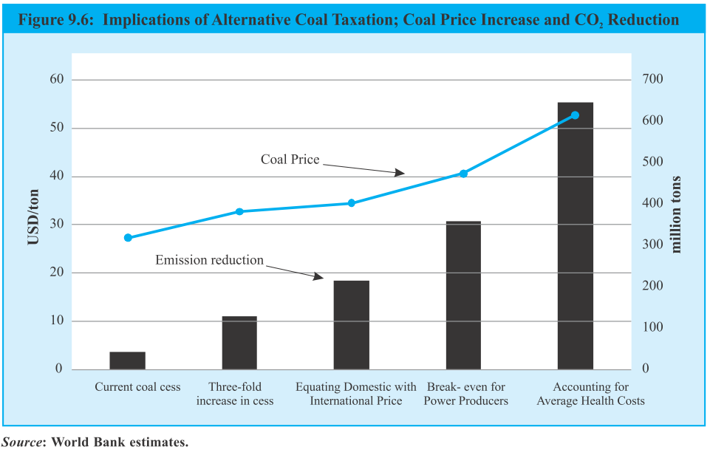
Coal: Increase Cess to what level? Survey: keep cheap energy for poor in mind

Slide 81
National finance, funding against Climate change
Taxation
Budget 2015
NAPCCC
Nehru
Funds
New funds
Coal Cess
PAT
Misc.
CAMPA
PSL

Slide 82

Timeline
NAPCC
2008: the National Action Plan on Climate Change (NAPCC).
2009: State Action Plans on Climate Change.
Will update it based on IPCC AR5

Slide 83
NAPCC: Missions
2 to ▲ Knowledge Base
Sustainable habitat=>building code
Strategic knowledge
4 Planned (Jan 2015)
Wind mission- similar to solar (MNRE)
Human Health: CC impact, Disaster Emergency
Coastal resource Management
Waste to energy mission.

Slide 84
NAPCC: Missions
3 to adapt to CC
Agriculture
Water
Himalayan eco system
3 to reduce GHG
Solar energy=>Jawahar
Green India: Afforestation (~24%=>33%), CAMPA fund
energy efficiency =>BEE, PAT

Slide 85

PAT 2011
NAPCC
NAPCC => NAT.Mission on Enhanced Energy efficiency
Perform, achieve, trade (PAT)
Legally binding on selected industries under Energy conservation Act 2001, else 10 lakh fine
Find baseline (current energy consumption in your company)
Set target for energy reduction
BEE audit & trading

Slide 86
Escert (DEMAT): 1 Metric Tonne of Oil Equivalent
Cement
Paper-Pulp
Target 6 unit reduce
But achieved 7 unit
1 Energy saving Cert. (ESCert) ++
Target 6 unit ▼
But only 5 unit ▼
Buy 1 ESCert

Slide 87

Nehru Solar Mission
Solar
Jawaharlal Nehru National Solar Mission (JNNSM)
2010: launched under MNRE
2022: 20,000 1 lakh* MW grid connected solar power (*budget-2015)
Solar 1 lakh MW = 100 GW.
Present ~3.3 GW
Total renewable Target 175 GW

Slide 88
Nehru Solar Mission
Solar
Phase-1
2010-13
Phase-2
2013-17
Phase-3
2017-22
Off grid
Indigenous production

Slide 89
Nehru Solar boost to indigenous
NAPCC
Need ~100 billion$ investment
JNNSM to give $$ to Army, Railways and PSUs to buy solar equipment ONLY if domestic mfg.
Pro: make in India promoted
Anti: non tariff barrier. US companies complaint in WTO

Slide 90
1st controversy= desi mfg vs WTO. 2nd contro: Bundling plan
Thermal ~Rs.3.5 /Unit
Solar: ~Rs.5-7/unit
Thermal : Solar 2:1 ratio, then sell
Result: costly electricity, But Discom already in 3.5 lakh cr. Loss

Slide 91
Renewable Energy (as of 31/12/2014)
Present Total 33.8 GW
Target: 175 GW
Largest to smallest: Wind (66%) > biomass > small hydro power > solar power. (Survey vol2.page 124)
11 lakh families use solar electricity for light and biogas for cooking.
Guj + Raj solar parks.= 50% contribute to grid connected solar energy.

Slide 92
CSAT 2014: Find correct Statement
‘Photovoltaics’ technology converts sunlight into electricity, while ‘Solar Thermal’ uses solar heat to produce electricity.
Photovoltaics generates AC, while Solar Thermal generates Direct Current (DC).
India has mfg. base for Solar Thermal technology, but not for Photovoltaics.
None of above
Ans. Only A

Slide 93
National finance, funding against Climate change
Taxation
Budget 2015
NAPCCC
Nehru
Funds
New funds
Coal Cess
PAT
Misc.
CAMPA
PSL

Slide 94

Adaptation fund
Budget 2014
Budget 2014: National Adaptation Fund (100 crores), Focus on agriculture, water, and forestry.
Green Law Panel: Environment Reconstruction fund. (L8/P1.pptx, Slide #64)

Slide 95
National finance, funding against Climate change
Taxation
Budget 2015
NAPCCC
Nehru
Funds
New funds
Coal Cess
PAT
Misc.
CAMPA
PSL

Slide 96
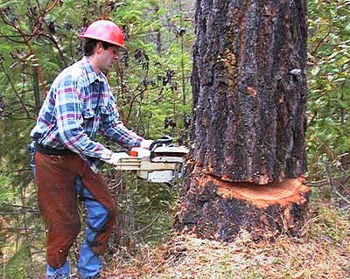
Afforestation
CAMPA
Forest land diverted to non-forest
Company has to give $$ to Compensatory afforestation fund
Rs. 40k crores so far
SC ordered Compensatory afforestation Management and planning authority
New bill proposed for statutory bodies, $$ to go in public account.
Green Law Panel: raise ratio, 5x formula (L8/P1.pptx)

Slide 97
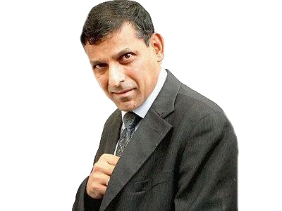
Priority sector lending
PSL
April 2015 update
PSL target 40%**
Loans to Renewable energy projects counted

Slide 98
Misc. terms and Development

Slide 99
Environment
LED program
Bharat stage-IV norms
Canal top solar plants
Net metering
Earth Overshoot
Air quality index
mrunal.org/environment

Slide 100
Env. Vs Economy
1st world vs 3rd World
Climate Finance
Environment clearance
Today’s topic
Rio Evolution
Intl. Finance
Natl. Finance
Kyoto to Paris
India’s Stand

